Slide 1
Chapter 1
Getting Started with PHP
PHP Programming with MySQL
2nd Edition

Slide 2
Objectives
In this chapter you will:
Create PHP scripts
Create PHP code blocks
Work with variables and constants
Study data types
Use expressions and operators
PHP Programming with MySQL, 2nd Edition

Slide 3
Creating Basic PHP Scripts
Embedded language refers to code that is embedded within a Web page (XHTML document)
PHP code is typed directly into a Web page as
a separate section
A Web page containing PHP code must be saved with an extension of .php to be processed by the scripting engine
PHP code is never sent to a client’s Web browser; only the output of the processing is sent to the browser
PHP Programming with MySQL, 2nd Edition

Slide 4
Creating Basic PHP Scripts (continued)
The Web page generated from the PHP code, and XHTML elements found within the PHP file, is returned to the client
A PHP file that does not contain any PHP code should be saved with an .html extension
.php is the default extension that most Web servers use to process PHP scripts
PHP Programming with MySQL, 2nd Edition

Slide 5
Creating PHP Code Blocks
Code declaration blocks are separate sections on a Web page that are interpreted by the scripting engine
There are four types of code declaration blocks:
  Standard PHP script delimiters
  The <script> element
  Short PHP script delimiters
  ASP-style script delimiters
PHP Programming with MySQL, 2nd Edition

Slide 6
Standard PHP Script Delimiters
A delimiter is a character or sequence of characters used to mark the beginning and end of a code segment
The standard method of writing PHP code declaration blocks is to use the <?php and ?> script delimiters
The individual lines of code that make up a PHP script are called statements
PHP Programming with MySQL, 2nd Edition

Slide 7
The <script> Element
The <script> element identifies a script section in a Web page document
Assign a value of "php" to the language attribute of the <script> element to identify the code block as PHP
PHP Programming with MySQL, 2nd Edition

Slide 8
Short PHP Script Delimiters
The syntax for the short PHP script delimiters is
  <? statements; ?>
Short delimiters can be disabled in a Web server’s php.ini configuration file
PHP scripts will not work if your Web site ISP does not support short PHP script delimiters
Short delimiters can be used in XHTML documents, but not in XML documents
PHP Programming with MySQL, 2nd Edition

Slide 9
ASP-Style Script Delimiters
The syntax for the ASP-style script delimiters is
<% statements; %>
ASP-style script delimiters can be used in XHTML documents, but not in XML documents
ASP-style script delimiters can be enabled or disabled in the php.ini configuration file
To enable or disable ASP-style script delimiters, assign a value of “On” or “Off ” to the asp_tags directive in the php.ini configuration file
PHP Programming with MySQL, 2nd Edition

Slide 10
Understanding Functions
A function is a subroutine (or individual statements grouped into a logical unit) that performs a specific task
  To execute a function, you must invoke, or call, it from somewhere in the script
A function call is the function name followed by
any data that the function needs
The data (in parentheses following the function name) are called arguments or actual parameters
Sending data to a called function is called passing arguments
PHP Programming with MySQL, 2nd Edition

Slide 11
Displaying Script Results
The echo and print statements are language constructs (built-in features of a programming language) that create new text on a Web page that is returned as a response to a client
The text passed to the echo statement is called a “literal string” and must be enclosed in either single or double quotation marks
To pass multiple arguments to the echo statement, separate the statements with commas
PHP Programming with MySQL, 2nd Edition

Slide 12
Displaying Script Results (continued)
Use the echo and print statements to return the results of a PHP script within a Web page that is returned to a client
The print statement returns a value of 1 if successful or a value of 0 if not successful, while the echo statement does not return a value
PHP Programming with MySQL, 2nd Edition

Slide 13
Creating Multiple Code Declaration Blocks
For multiple script sections in a document, include a separate code declaration block for each section
  ...
  </head>
  <body>
  <h1>Multiple Script Sections</h1>
  <h2>First Script Section</h2>
  <?php echo "<p>Output from the first script section.</p>";
  ?>
  <h2>Second Script Section</h2>
  <?php echo "<p>Output from the second script
  section.</p>";?>
  </body>
  </html>
PHP Programming with MySQL, 2nd Edition

Slide 14
Creating Multiple Code Declaration Blocks (continued)
PHP code declaration blocks execute on a Web server before a Web page is sent to a client
  ...
  </head>
  <body>
  <h1>Multiple Script Sections</h1>
  <h2>First Script Section</h2>
  <p>Output from the first script section.</p>
  <h2>Second Script Section</h2>
  <p>Output from the second script section.</p>
  </body>
  </html>
PHP Programming with MySQL, 2nd Edition

Slide 15
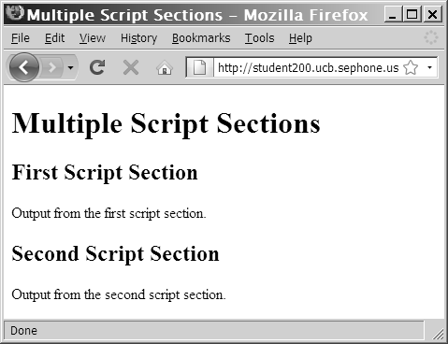
Creating Multiple Code Declaration Blocks (continued)
Figure 1-9 Output of a document with two PHP script sections
PHP Programming with MySQL, 2nd Edition

Slide 16
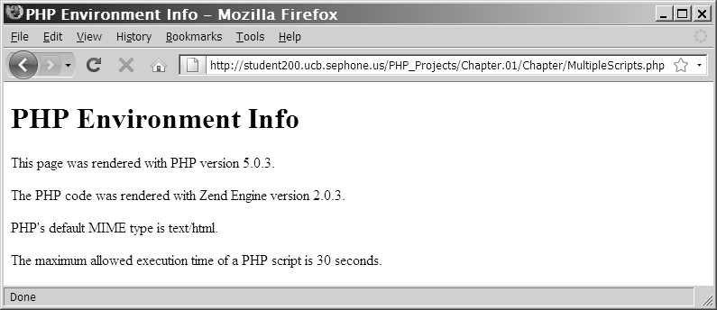
Creating Multiple Code Declaration Blocks (continued)
Figure 1-10 PHP Environment Information Web page
PHP Programming with MySQL, 2nd Edition

Slide 17
Case Sensitivity in PHP
Programming language constructs in PHP are mostly case insensitive
<?php
echo "<p>Explore <strong>Africa</strong>, <br />";
Echo "<strong>South America</strong>, <br />";
ECHO " and <strong>Australia</strong>!</p>";
?>
PHP Programming with MySQL, 2nd Edition

Slide 18
Adding Comments to a PHP Script
Comments are nonprinting lines placed in code that do not get executed, but provide helpful information, such as:
  The name of the script
  Your name and the date you created the program
  Notes to yourself
  Instructions to future programmers who might need to modify your work
PHP Programming with MySQL, 2nd Edition

Slide 19
Adding Comments to a PHP Script (continued)
Line comments hide a single line of code
  Add // or # before the text
Block comments hide multiple lines of code
  Add /* to the first line of code
  And */ after the last character in the code
PHP Programming with MySQL, 2nd Edition

Slide 20
Adding Comments to a PHP Script (continued)
  <?php
  /*
  This line is part of the block comment.
  This line is also part of the block comment.
  */
  echo "<h1>Comments Example</h1>"; // Line comments can follow
  code statements
  // This line comment takes up an entire line.
  # This is another way of creating a line comment.
  /* This is another way of creating
  a block comment. */
  ?>
PHP Programming with MySQL, 2nd Edition

Slide 21
Using Variables and Constants
The values stored in computer memory are called variables
The values, or data, contained in variables are classified into categories known as data types
The name you assign to a variable is called an identifier
An identifier must begin with a dollar sign ($), may not include a number or underscore as the first character, cannot include spaces, and is case sensitive
PHP Programming with MySQL, 2nd Edition

Slide 22
Displaying Variables
To display a variable with the echo statement, pass the variable name to the echo
statement without enclosing it in quotation marks:
  $VotingAge = 18;
  echo $VotingAge;
To display both text strings and variables, send
them to the echo statement as individual arguments, separated by commas:
echo "<p>The legal voting age is ", $VotingAge, ".</p>";
PHP Programming with MySQL, 2nd Edition

Slide 23
Naming Variables
The name you assign to a variable is called an identifier
The following rules and conventions must be followed when naming a variable:
  Identifiers must begin with a dollar sign ($)
  Identifiers may contain uppercase and lowercase letters, numbers, or underscores (_). The first character after the dollar sign must be a letter.
  Identifiers cannot contain spaces
  Identifiers are case sensitive
PHP Programming with MySQL, 2nd Edition

Slide 24
Declaring and Initializing Variables
Specifying and creating a variable name is called declaring the variable
Assigning a first value to a variable is called initializing the variable
In PHP, you must declare and initialize a variable in the same statement:
  $variable_name = value;
PHP Programming with MySQL, 2nd Edition

Slide 25
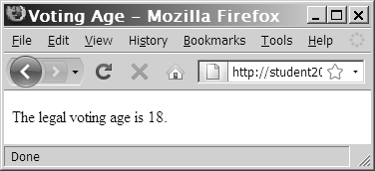
Displaying Variables
Figure 1-11 Output from an echo statement
that is passed text and a variable
PHP Programming with MySQL, 2nd Edition

Slide 26
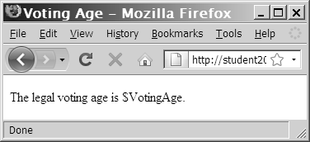
Displaying Variables (continued)
The output of variable names inside a text string depends on whether the string is surrounded by double or single quotation marks
Figure 1-12 Output of an echo statement that includes text and a variable surrounded by single quotation marks
PHP Programming with MySQL, 2nd Edition

Slide 27
Modifying Variables
You can modify a variable’s value at any point in a script
$SalesTotal = 40;
echo "<p>Your sales total is
$$SalesTotal</p>";
$SalesTotal = 50;
echo "<p>Your new sales total is $$SalesTotal</p>";
PHP Programming with MySQL, 2nd Edition

Slide 28
Defining Constants
A constant contains information that does not change during the course of program execution
Constant names do not begin with a dollar sign ($)
Constant names use all uppercase letters
Use the define() function to create a constant
  define("CONSTANT_NAME", value);
The value you pass to the define() function can be a text string, number, or Boolean value
PHP Programming with MySQL, 2nd Edition

Slide 29
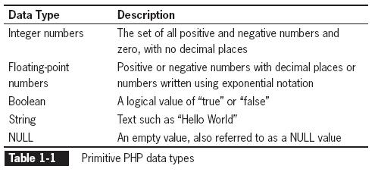
Working with Data Types
A data type is the specific category of information that a variable contains
Data types that can be assigned only a single value are called primitive types
PHP Programming with MySQL, 2nd Edition

Slide 30
Working with Data Types (continued)
The PHP language supports:
  A resource data type – a special variable that holds a reference to an external resource such
  as a database or XML file
  Reference or composite data types, which contain multiple values or complex types of information
  Two reference data types: arrays and objects
PHP Programming with MySQL, 2nd Edition

Slide 31
Working with Data Types (continued)
Strongly typed programming languages require you to declare the data types of variables
Static or strong typing refers to data types that do not change after they have been declared
Loosely typed programming languages do not require you to declare the data types of variables
Dynamic or loose typing refers to data types that can change after they have been declared
PHP Programming with MySQL, 2nd Edition

Slide 32
Numeric Data Types
PHP supports two numeric data types:
  An integer is a positive or negative number and 0 with no decimal places (-250, 2, 100, 10,000)
  A floating-point number is a number that contains decimal places or that is written in exponential notation (-6.16, 3.17, 2.7541)
    Exponential notation, or scientific notation, is a shortened format for writing very large numbers or numbers with many decimal places (2.0e11)
PHP Programming with MySQL, 2nd Edition

Slide 33
Boolean Values
A Boolean value is a value of TRUE or FALSE
It decides which part of a program should execute and which part should compare data
In PHP programming, you can only use TRUE or FALSE Boolean values
In other programming languages, you can use integers such as 1 = TRUE, 0 = FALSE
PHP Programming with MySQL, 2nd Edition

Slide 34
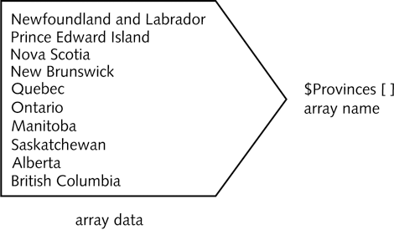
Arrays
An array contains a set of data represented by a single variable name
Figure 1-17 Conceptual example of an array
PHP Programming with MySQL, 2nd Edition

Slide 35
Declaring and Initializing Indexed Arrays
An element refers to each piece of data that is stored within an array
An index is an element’s numeric position within the array
  By default, indexes begin with the number zero (0)
  An element is referenced by enclosing its index in brackets at the end of the array name:
  $Provinces[1]
PHP Programming with MySQL, 2nd Edition

Slide 36
Declaring and Initializing Indexed Arrays (continued)
The array() construct syntax is:
  $array_name = array(values);
  $Provinces = array(
  "Newfoundland and Labrador",
  "Prince Edward Island",
  "Nova Scotia",
  "New Brunswick",
  "Quebec",
  "Ontario",
  "Manitoba",
  "Saskatchewan",
  "Alberta",
  "British Columbia"
  );
PHP Programming with MySQL, 2nd Edition

Slide 37
Declaring and Initializing Indexed Arrays (continued)
Array name and brackets syntax is:
$array_name[ ]
$Provinces[] = "Newfoundland and Labrador";
$Provinces[] = "Prince Edward Island";
$Provinces[] = "Nova Scotia";
$Provinces[] = "New Brunswick";
$Provinces[] = "Quebec";
$Provinces[] = "Ontario";
$Provinces[] = "Manitoba";
$Provinces[] = "Saskatchewan";
$Provinces[] = "Alberta";
$Provinces[] = "British Columbia";
PHP Programming with MySQL, 2nd Edition

Slide 38
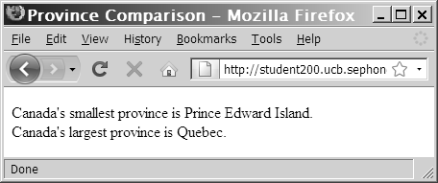
Accessing Element Information (continued)
  echo "<p>Canada's smallest province is $Provinces[1].<br />";
  echo "Canada's largest province is $Provinces[4].</p>";
Figure 1-18 Output of elements in the $Provinces[] array
PHP Programming with MySQL, 2nd Edition

Slide 39
Accessing Element Information
(continued)
Use the count() function to find the total number of elements in an array
$Provinces = array("Newfoundland and Labrador", "Prince Edward
Island", "Nova Scotia", "New Brunswick", "Quebec", "Ontario", " Manitoba", "Saskatchewan", "Alberta", "British Columbia");
$Territories = array("Nunavut", "Northwest Territories", "Yukon
Territory");
echo "<p>Canada has ", count($Provinces), " provinces and ",
count($Territories), " territories.</p>";
PHP Programming with MySQL, 2nd Edition

Slide 40
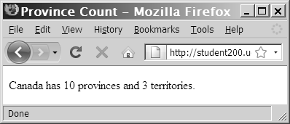
Accessing Element Information (continued)
Figure 1-19 Output of the count() function
PHP Programming with MySQL, 2nd Edition

Slide 41
Accessing Element Information (continued)
Use the print_r(), var_dump() or var_export() functions to display or return information about variables
  The print_r() function displays the index and value of each element in an array
  The var_dump() function displays the index, value, data type and number of characters in the value
  The var_export() function is similar to var_dump() function except it returns valid PHP code
PHP Programming with MySQL, 2nd Edition

Slide 42
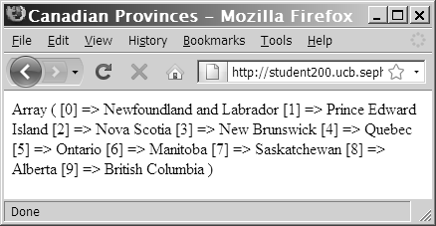
Accessing Element Information (continued)
Figure 1-21 Output of the $Provinces[ ] array with the
print_r() function
PHP Programming with MySQL, 2nd Edition

Slide 43
Modifying Elements
To modify an array element. include the index for an individual element of the array:
$HospitalDepts = array(
"Anesthesia", // first element(0)
"Molecular Biology", // second element (1)
"Neurology"); // third element (2)
To change the first array element in the $HospitalDepts[] array from “Anesthesia” to “Anesthesiology” use:
$HospitalDepts[0] = "Anesthesiology";
PHP Programming with MySQL, 2nd Edition

Slide 44
Avoiding Assignment Notation Pitfalls
Assigns the string “Hello” to a variable named $list
$list = "Hello";
Assigns the string “Hello” to a new element appended to the end of the $list array
$list[] = "Hello";
Replaces the value stored in the first element (index 0) of the $list array with the string “Hello”
$list[0] = "Hello";
PHP Programming with MySQL, 2nd Edition

Slide 45
Building Expressions
An expression is a literal value or variable that can be evaluated by the PHP scripting engine to produce a result
Operands are variables and literals contained in an expression
A literal is a static value such as a literal string or a number
Operators are symbols (+) (*) that are used in expressions to manipulate operands
PHP Programming with MySQL, 2nd Edition

Slide 46
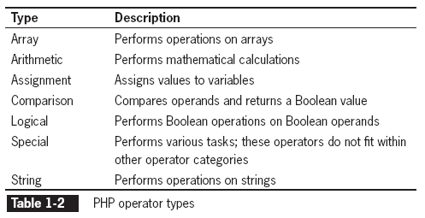
Building Expressions (continued)
PHP Programming with MySQL, 2nd Edition

Slide 47
Building Expressions (continued)
A binary operator requires an operand before and after the operator
  $MyNumber = 100;
A unary operator requires a single operand either before or after the operator
PHP Programming with MySQL, 2nd Edition

Slide 48
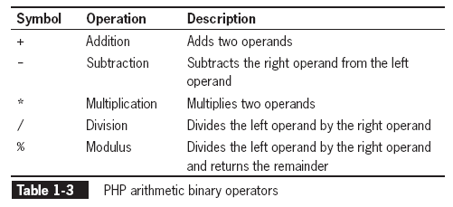
Arithmetic Operators
Arithmetic operators are used in PHP to perform mathematical calculations (+ - x ÷)
PHP Programming with MySQL, 2nd Edition

Slide 49
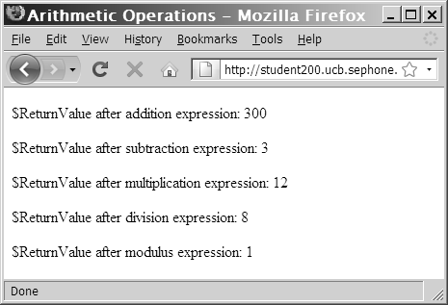
Arithmetic Operators (continued)
Figure 1-22 Results of arithmetic expressions
PHP Programming with MySQL, 2nd Edition

Slide 50
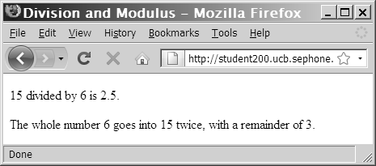
Arithmetic Operators (continued)
  $DivisionResult = 15 / 6;
  $ModulusResult = 15 % 6;
  echo "<p>15 divided by 6 is
  $DivisionResult.</p>"; // prints '2.5'
  echo "The whole number 6 goes into 15 twice, with a
  remainder of $ModulusResult.</p>"; // prints '3'
Figure 1-23 Division and modulus expressions
PHP Programming with MySQL, 2nd Edition

Slide 51
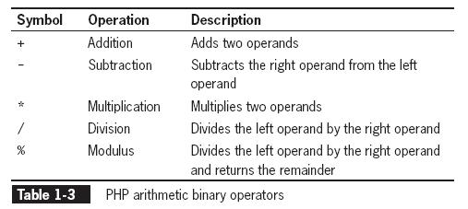
Arithmetic Binary Operators
PHP Programming with MySQL, 2nd Edition

Slide 52
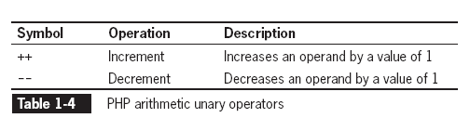
Arithmetic Unary Operators
The increment (++) and decrement (--) unary operators can be used as prefix or postfix operators
A prefix operator is placed before a variable
A postfix operator is placed after a variable
PHP Programming with MySQL, 2nd Edition

Slide 53
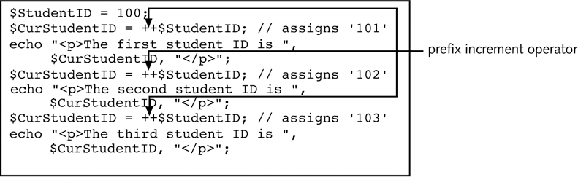
Arithmetic Unary Operators (continued)
Figure 1-24 Script that uses the prefix
increment operator
PHP Programming with MySQL, 2nd Edition

Slide 54
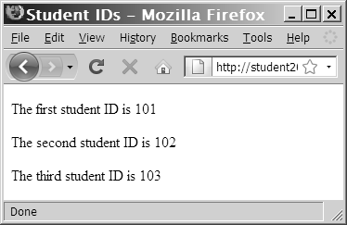
Arithmetic Unary Operators (continued)
Figure 1-25 Output of the prefix version of the student ID script
PHP Programming with MySQL, 2nd Edition

Slide 55
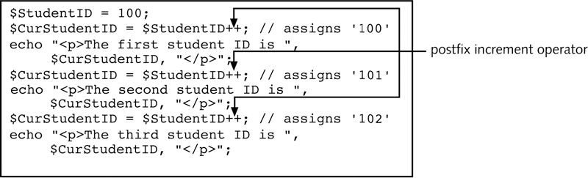
Arithmetic Unary Operators (continued)
Figure 1-26 Script that uses the postfix increment operator
PHP Programming with MySQL, 2nd Edition

Slide 56
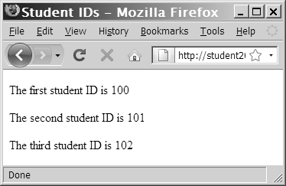
Arithmetic Unary Operators (continued)
Figure 1-27 Output of the postfix version of the student ID script
PHP Programming with MySQL, 2nd Edition

Slide 57
Assignment Operators
Assignment operators are used for assigning
a value to a variable:
$MyFavoriteSuperHero = "Superman";
$MyFavoriteSuperHero = "Batman";
Compound assignment operators perform mathematical calculations on variables and literal values in an expression, and then assign
a new value to the left operand
PHP Programming with MySQL, 2nd Edition

Slide 58
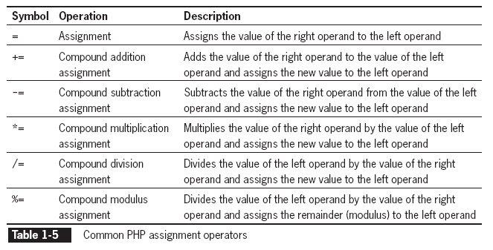
Assignment Operators (continued)
PHP Programming with MySQL, 2nd Edition

Slide 59
Comparison and Conditional Operators
Comparison operators are used to compare two operands and determine how one operand compares to another
A Boolean value of TRUE or FALSE is returned after two operands are compared
The comparison operator compares values, whereas the assignment operator assigns values
Comparison operators are used with conditional statements and looping statements
PHP Programming with MySQL, 2nd Edition

Slide 60
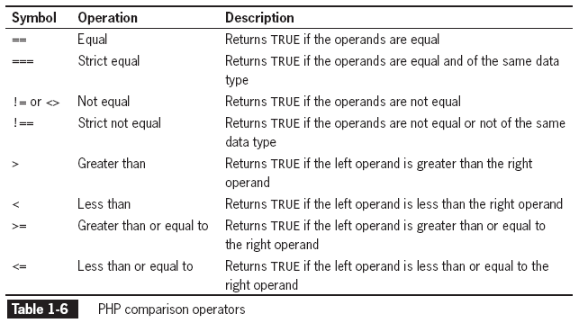
Comparison and Conditional Operators (continued)
PHP Programming with MySQL, 2nd Edition

Slide 61
Comparison and Conditional Operators (continued)
The conditional operator executes one of two expressions, based on the results of a conditional expression
The syntax for the conditional operator is:
conditional expression ? expression1 :
expression2;
If the conditional expression evaluates to TRUE, expression1 executes
If the conditional expression evaluates to FALSE, expression2 executes
PHP Programming with MySQL, 2nd Edition

Slide 62
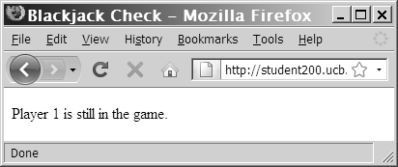
Comparison and Conditional Operators (continued)
  $BlackjackPlayer1 = 20;
  ($BlackjackPlayer1 <= 21) ? $Result =
  "Player 1 is still in the game. " : $Result =
  "Player 1 is out of the action.";
  echo "<p>", $Result, "</p>";
Figure 1-31 Output of a script with a conditional operator
PHP Programming with MySQL, 2nd Edition

Slide 63
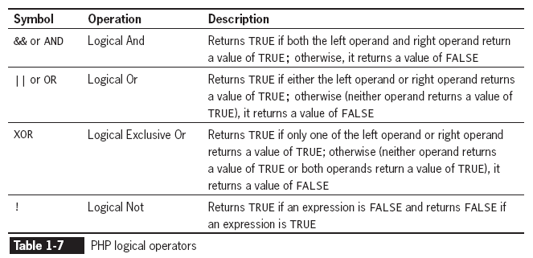
Logical Operators
Logical operators are used for comparing two Boolean operands for equality
A Boolean value of TRUE or FALSE is returned after two operands are compared
PHP Programming with MySQL, 2nd Edition

Slide 64
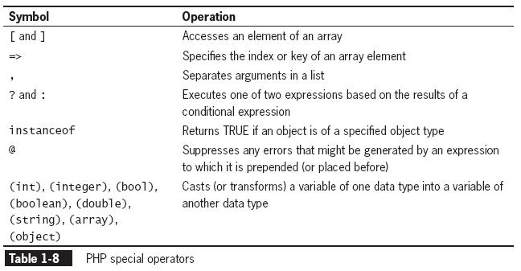
Special Operators
PHP Programming with MySQL, 2nd Edition

Slide 65
Type Casting
Casting or type casting copies the value contained in a variable of one data type into a variable of another data type
The PHP syntax for casting variables is:
$NewVariable = (new_type) $OldVariable;
(new_type) refers to the type-casting operator representing the type to which you want to cast the variable
PHP Programming with MySQL, 2nd Edition

Slide 66
Type Casting (continued)
Returns one of the following strings, depending on the data type:
  Boolean
  Integer
  Double
  String
  Array
  Object
  Resource
  NULL
  Unknown type
PHP Programming with MySQL, 2nd Edition

Slide 67
Understanding Operator Precedence
Operator precedence refers to the order in which operations in an expression are evaluated
Associativity is the order in which operators of equal precedence execute
Associativity is evaluated on a left-to-right or a right-to-left basis
PHP Programming with MySQL, 2nd Edition

Slide 68
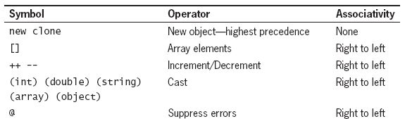
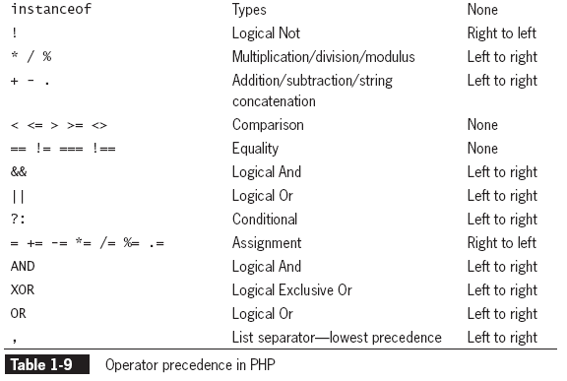
Understanding Operator Precedence (continued)
PHP Programming with MySQL, 2nd Edition

Slide 69
Summary
JavaScript and PHP are both referred to as embedded languages because code for both languages is embedded within a Web page (either an HTML or XHTML document)
You write PHP scripts within code declaration blocks, which are separate sections within a Web page that are interpreted by the scripting engine
The individual lines of code that make up a PHP script are called statements
PHP Programming with MySQL, 2nd Edition

Slide 70
Summary (continued)
The term, function, refers to a procedure (or individual statements grouped into a logical unit) that performs a specific task
Comments are lines that you place in code to contain various types of remarks, including the name of the script, your name and the date you created the program, notes to yourself, or instructions to future programmers who might need to modify your work
  Comments do not display in the browser
PHP Programming with MySQL, 2nd Edition

Slide 71
Summary (continued)
The values a program stores in computer memory are commonly called variables
The name you assign to a variable is called an identifier
A constant contains information that cannot change during the course of program execution
A data type is the specific category of information that a variable contains
PHP is a loosely-typed programming language
PHP Programming with MySQL, 2nd Edition

Slide 72
Summary (continued)
An integer is a positive or negative number or zero, with no decimal places
A floating-point number contains decimal places or is written in exponential notation
A Boolean value is a logical value of TRUE or FALSE
An array contains a set of data represented by a single variable name
PHP Programming with MySQL, 2nd Edition

Slide 73
Summary (continued)
An expression is a single literal value or variable or a combination of literal values, variables, operators, and other expressions that can be evaluated by the PHP scripting engine to produce a result
Operands are variables and literals contained in an expression. A literal is a value such as a string or a number.
PHP Programming with MySQL, 2nd Edition

Slide 74
Summary (continued)
Operators are symbols used in expressions to manipulate operands, such as the addition operator (+) and multiplication operator (*)
A binary operator requires an operand before and after the operator
A unary operator requires a single operand either before or after the operator
PHP Programming with MySQL, 2nd Edition

Slide 75
Summary (continued)
Arithmetic operators are used in the PHP scripting engine to perform mathematical calculations, such as addition, subtraction, multiplication, and division
Assignment operators are used for assigning a value to a variable
Comparison operators are used to determine how one operand compares with another
PHP Programming with MySQL, 2nd Edition

Slide 76
Summary (continued)
The conditional operator executes one of two expressions, based on the results of a conditional expression
Logical operators are used to perform operations on Boolean operands
Casting or type casting creates an equivalent value in a specific data type for a given value
Operator precedence is the order in which operations in an expression are evaluated
PHP Programming with MySQL, 2nd Edition

